Slide 1
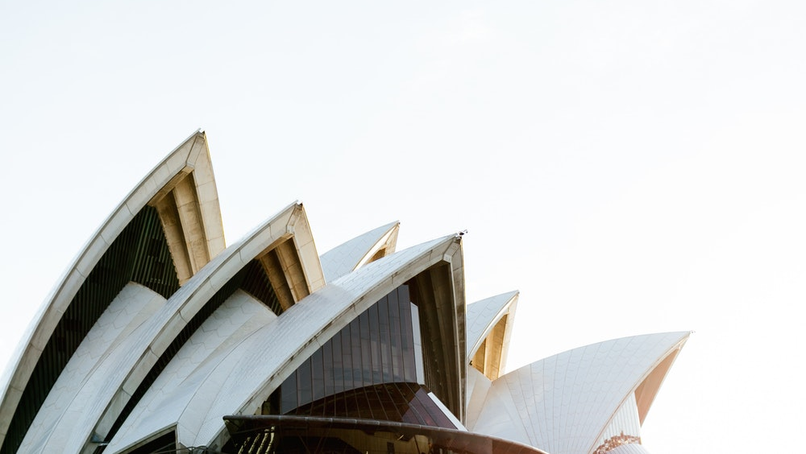
icomosga2020.org

Slide 2
General Assembly & Scientific Symposium 2020
This will be the first ICOMOS General Assembly in Australia or the Pacific
There is strong government and private sector support
The Australian Government and NSW State Government are providing substantial grant funding plus ‘in kind’ support
A full ten day program will be offered, with core activities and many optional extra events

Slide 3
GA2020 Components
GA2020 (1-10 October 2020) will comprise 5 parts:
ICOMOS business meetings
Youth Forum
Heritage Exhibition
Side events / Site visits
Scientific Symposium
GA2020 is being implemented through 4 committees:
GA2020 Organising Committee
GA2020 Executive Committee
GA2020 Indigenous Advisory Panel
GA2020 Risk Quality and Review Panel

Slide 4
Scientific Symposium
The theme for GA2020 is ‘shared cultures – shared heritage – shared responsibility’
4 day program, including a day visit to the Greater Blue Mountains World Heritage Area
Traditional Owner and Nature-Culture Journey streams and sessions
Dr Steve Brown is the Australian Co-Chair
Dr Ona Vileikis is the International Co-Chair
Themes and streams each have Australian and international Co-Chairs and committees
Diverse format, with multiple session options

Slide 5
International Scientific Committees and Heritage Exposition
There are 28 ICOMOS International Scientific Committees (ISCs)
Each ISC will be hosted for an AGM, and / or event
Tours and/or excursions will be available for delegates
Each ICOMOS ISC and National Committee will provide display content for a six day Heritage Exposition
The Heritage Exposition will run from 6 to 10 October at Darling Harbour and will be open to the public

Slide 6
Youth Forum
The Youth Forum will involve 120 – 150 delegates from around the world
Some financial assistance will be available to delegates from developing nations
There will be a 2-3 day program, leading in to the main Scientific Symposium
The venue will be Cockatoo Island – part of the ‘Australian Convict Sites’ World Heritage property
The Youth Forum is being organised by an active committee of emerging ICOMOS professionals, supported by the GA2020 Executive and the professional conference organisers

Slide 7
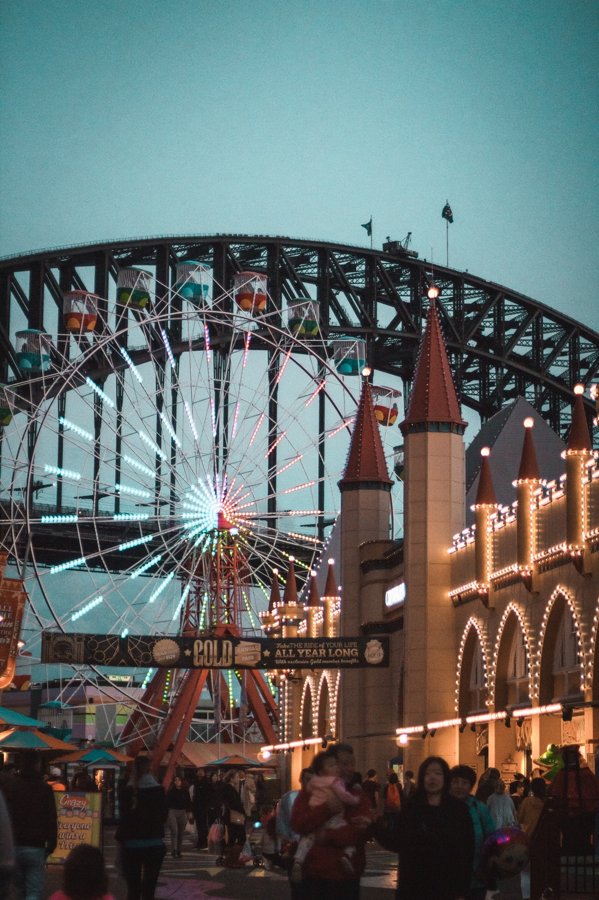
Social, Side Events and Public Program
The Opening Ceremony at the Sydney Opera House will include an Opera highlights performance
Luna Park Party – just for fun!
Hyde Park Barracks special inspections
Public lecture, exhibition and events
The ICOMOS Advisory Committee will be invited to a Lord Mayoral reception at Sydney Town Hall
The Closing Gala Dinner will be held at Sydney International Convention Centre
Site visits, tours and workshops will showcase a range of Australian cultural heritage places

Slide 8
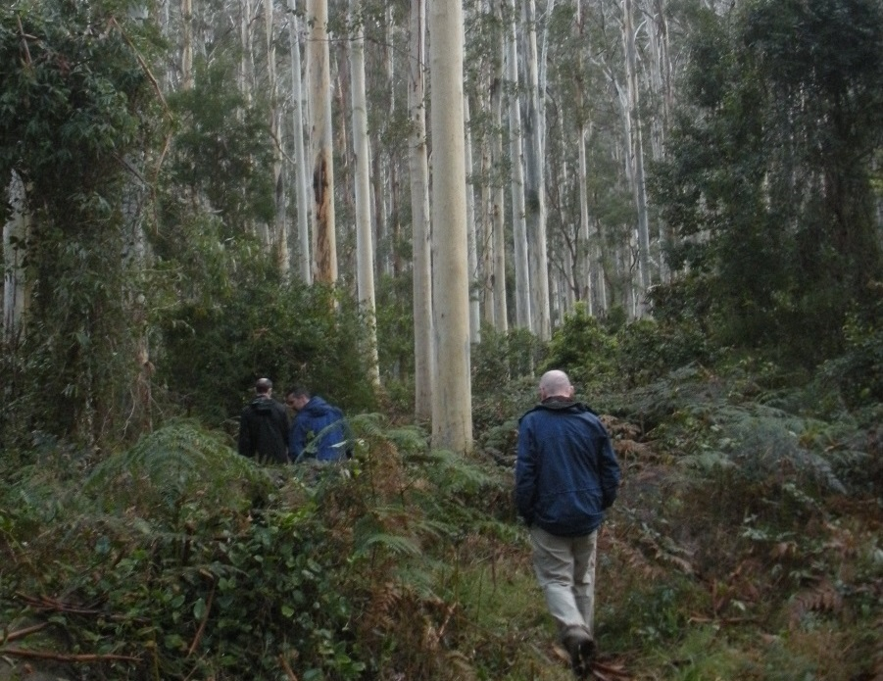
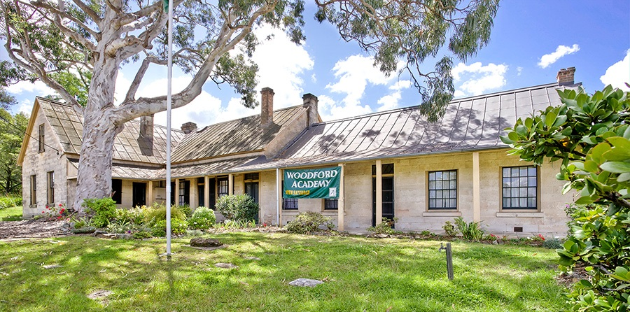
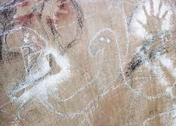
Greater Blue Mountains Visit
A highlight for the 1,200 – 1,500 global delegates will be a visit to the Greater Blue Mountains World Heritage Area:
40+ buses – English French and Spanish speakers
Different grades of ‘activity’ to suit delegate preferences
Natural and cultural heritage experiences
Blue Mountains National Park – National Trust properties – Blue Mountains Cultural Centre
NSW Parks Service and ICOMOS guides
Lunch and cultural experience at The Gully

Slide 9
GA2020 Ambassadors
Selected individuals who support and promote GA2020 by communicating with fellow cultural heritage practitioners. GA2020 Ambassadors will:
create interest and excitement amongst their networks to increase awareness of GA2020
develop relations with affiliated associations, individuals and local networks
seek organisations which can promote GA2020
work closely with Arinex, the professional conference organiser, to market GA2020
use the GA2020 Ambassadors’ online portal to share information and access promotional resources

Slide 10
Ambassador Benefits
A special Ambassador icon on GA2020 name badge
Invitation to the GA2020 VIP welcome function following the Opening Ceremony at the Sydney Opera House
Special tour of Sydney Opera House, guided by Alan Croker, author of the fourth edition of the Opera House’s conservation management plan, courtesy of the Sydney Opera House Trust; OR
Curator tour of the Mint and Hyde Park Barracks – part of the Australian Convict Sites’ World Heritage property, courtesy of Sydney Living Museums
VIP fast track registration queue
Register your interest at: icomosga2020.org

Slide 11
Strategic Partners

Slide 12
GA2020 – Key Dates
2 October 2019 | Scientific Symposium submissions open
4 November 2019 | Early bird registration opens
6 January 2020 | Scientific Symposium submissions close
29 April 2020 | Authors of successful Scientific Symposium submissions advised (first round)
May 2020: | Preliminary Scientific Symposium program published
3 June 2020: | Early bird registration closes
4 June - 29 September 2020 | Standard registration fees apply
31 July 2020: | Registration deadline for Scientific Symposium SS presenters
August 2020: | Revised SS program published
1-10 October 2020: | General Assembly and Scientific Symposium

Slide 13
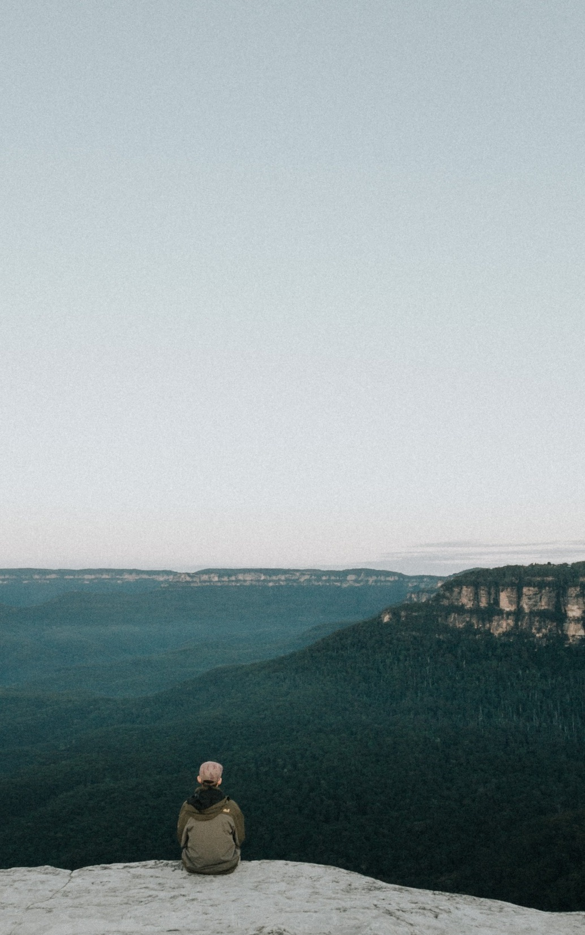
A Lasting Legacy
for cultural heritage and the communities that value and care for it in Australia and globally
networking and professional connections between practitioners and Traditional Owners
educational opportunities for professionals and students
exchange of information, skills and experience
increased government interest and support for cultural heritage
promotion of heritage advocacy
focus on the ‘Nature-Culture Journey’
positive media coverage and community-awareness
a boost in ‘grass roots’ interest in heritage

Slide 14
icomosga2020.org
Register your interest today

